Slide 1
Abstract class and Interface
Prof. Madonna Lamin

Slide 2
Table of Content
What is inheritance and the types of inheritance.
Why to use inheritance?
Behavior of constructors in inheritance
Concept of multilevel inheritance
Concept of Method Overriding
How to handle constructors in multilevel inheritance - using super() and this()
Significance of the final keyword

Slide 3
Table of content
Concept of abstract class in Java
What is an interface in Java?
Why and when to use interfaces in Java?
Creating and implementing interfaces in Java
Concept of interface reference
Significance of instanceof operator
Concept of Interface inheritance
What is the concept of dynamic method dispatch
Differentiate between abstract class and interface

Slide 4
Concept of inheritance in Java
Inheritance is a fundamental concept in object-oriented programming (OOP) that allows one class to inherit the properties and behaviors of another class. This promotes code reusability and establishes a relationship between classes. In Java, inheritance is implemented using the extends keyword.

Slide 5


Slide 6
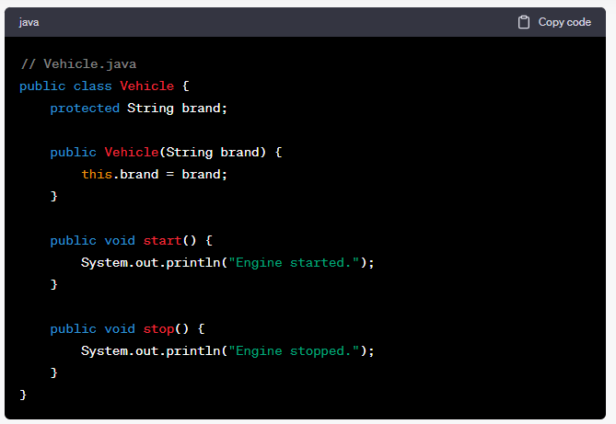

Slide 7


Slide 8
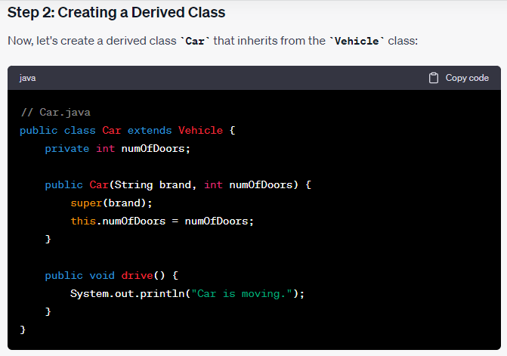

Slide 9
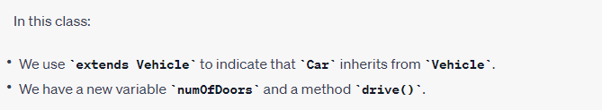

Slide 10


Slide 11
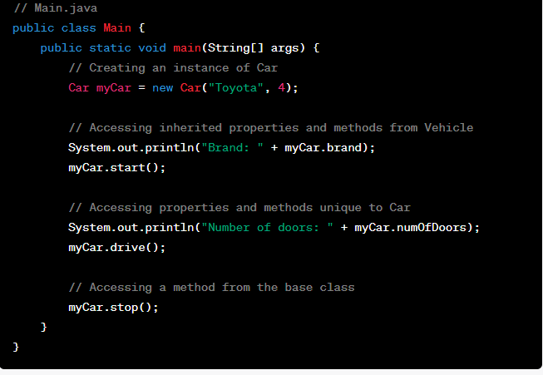

Slide 12
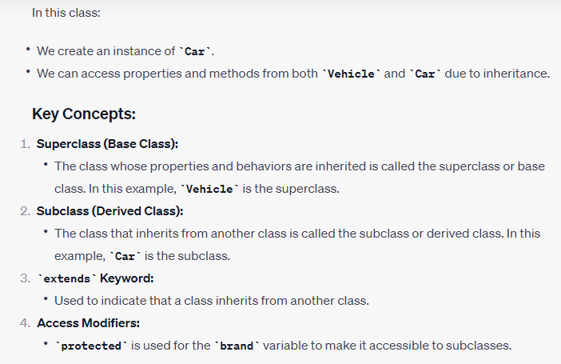

Slide 13
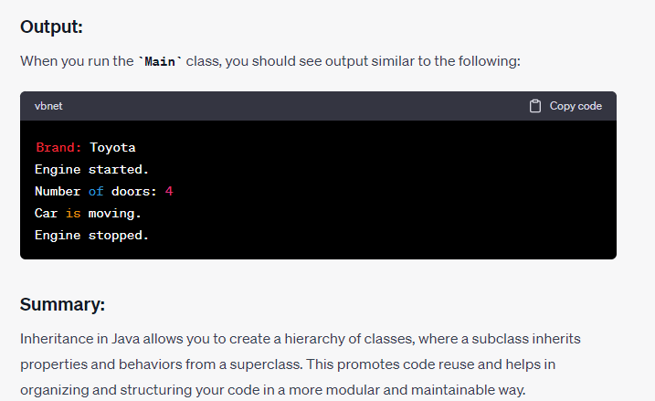

Slide 14
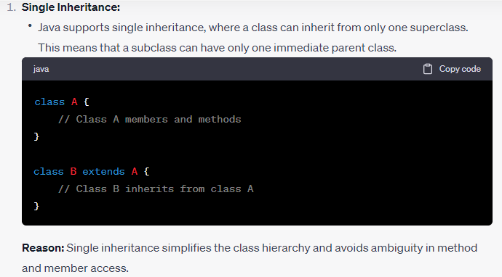
What are the types of inheritance Java supports and why or why not?

Slide 15
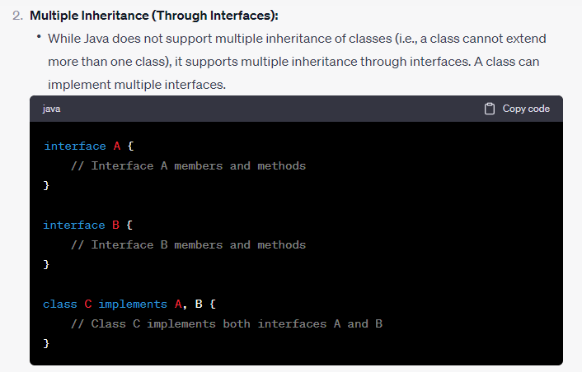

Slide 16
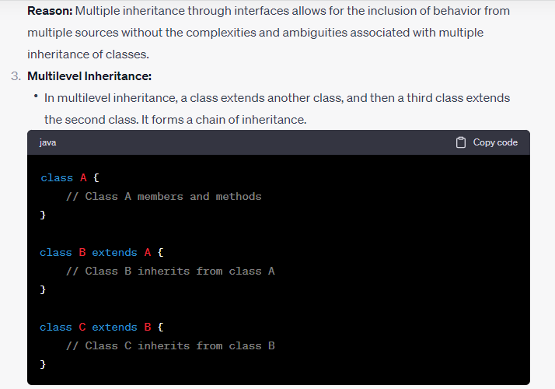

Slide 17
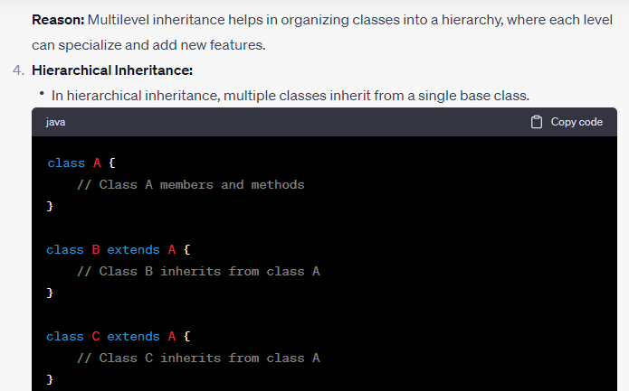

Slide 18
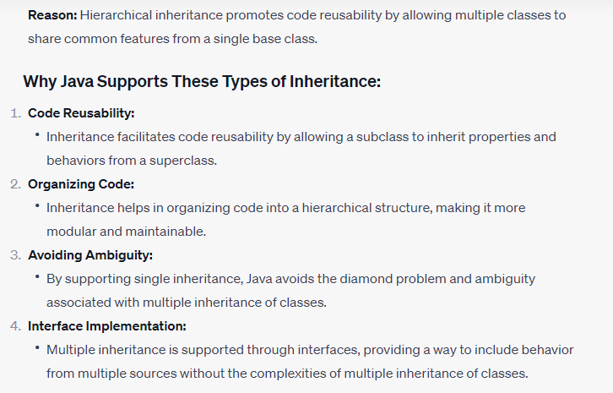

Slide 19
Behavior of constructors in inheritance
In Java, constructors play a crucial role in the process of inheritance. When a class inherits from another class, its constructors are involved in a specific way to ensure proper initialization of both the subclass and superclass.

Slide 20
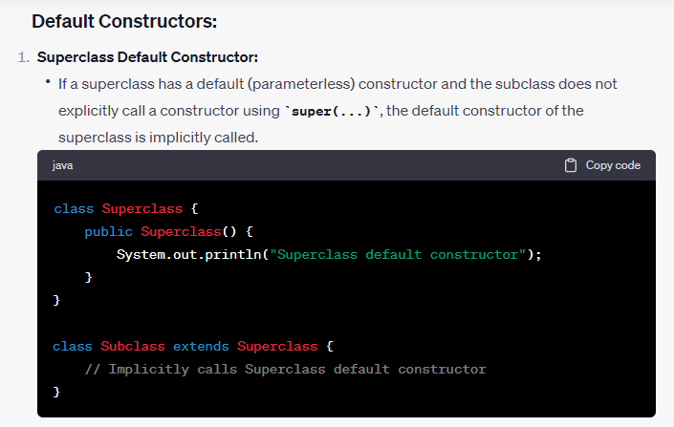

Slide 21
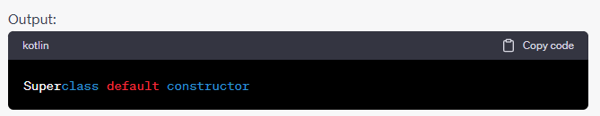

Slide 22
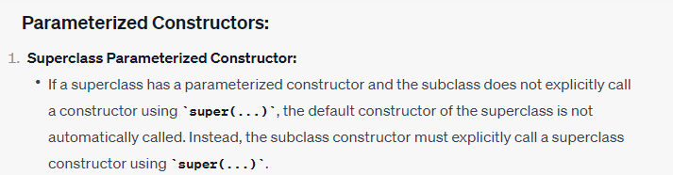

Slide 23
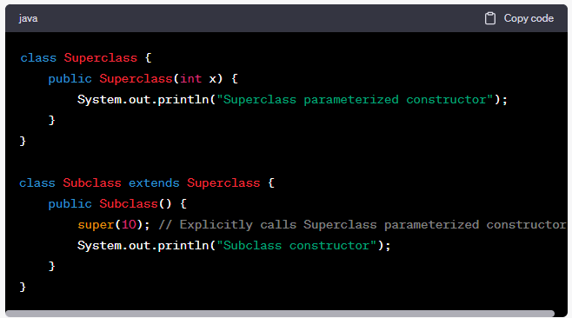

Slide 24
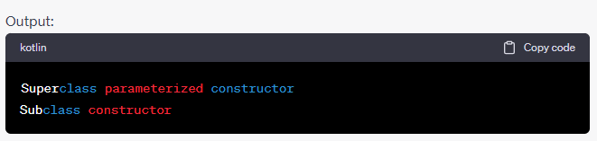

Slide 25
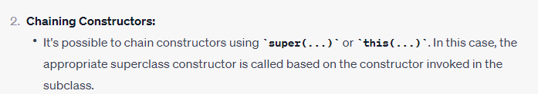

Slide 26
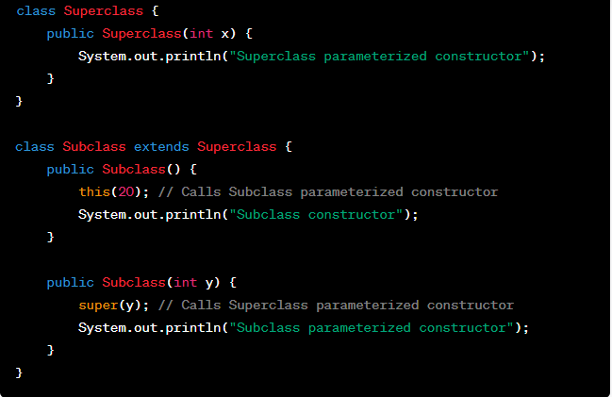

Slide 27
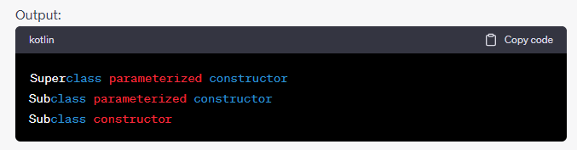

Slide 28
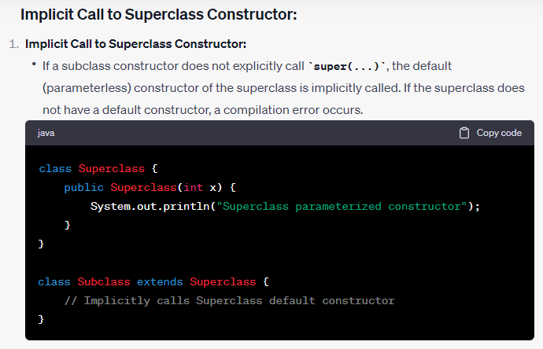

Slide 29
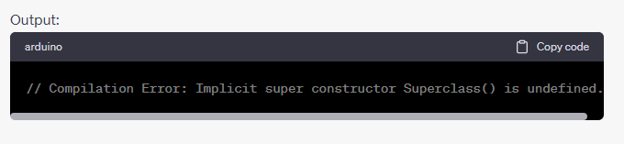

Slide 30
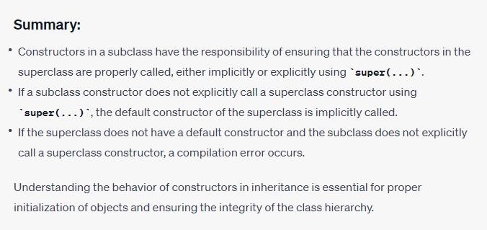

Slide 31
What is multilevel inheritance in Java?
In Java, multilevel inheritance refers to a situation where a class extends another class, and then a third class extends the second class. This creates a chain of inheritance, forming a multilevel hierarchy. In this hierarchy, each class inherits the properties and behaviors of its immediate parent class, and the chain can extend to more than two levels.

Slide 32
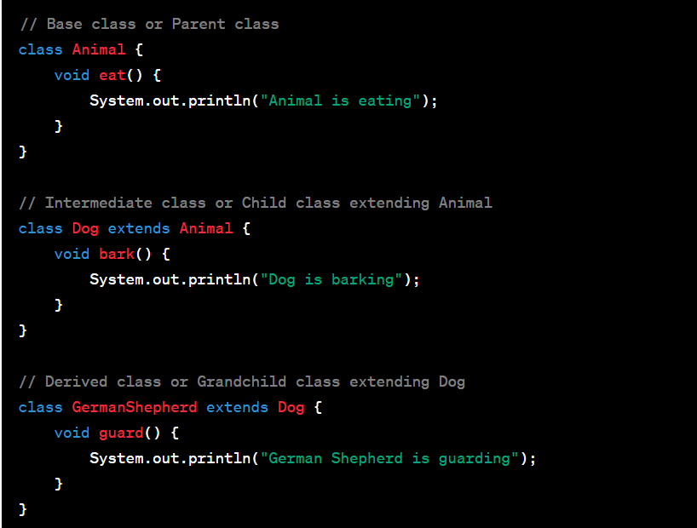

Slide 33
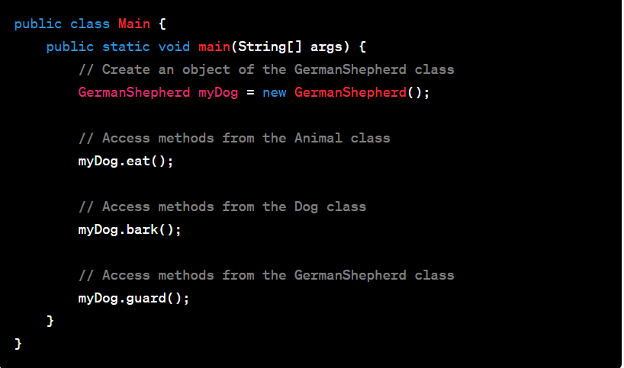

Slide 34
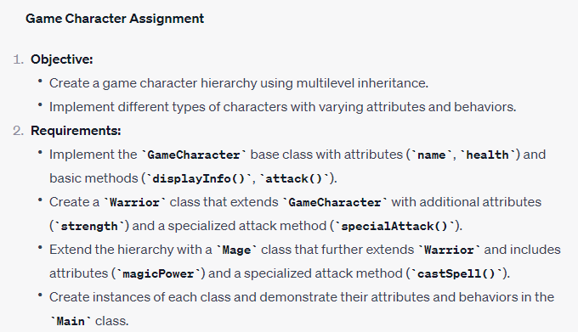
Game Character using multilevel inheritance
Objective:

Slide 35
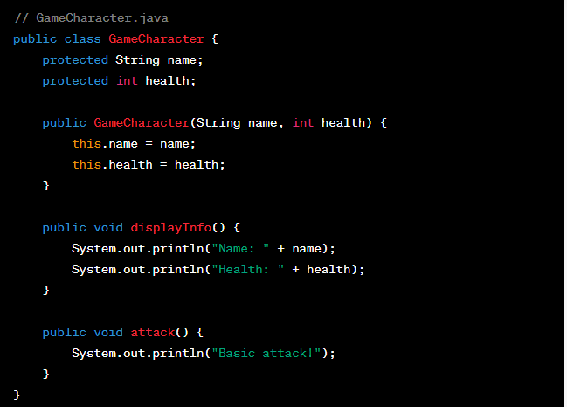

Slide 37
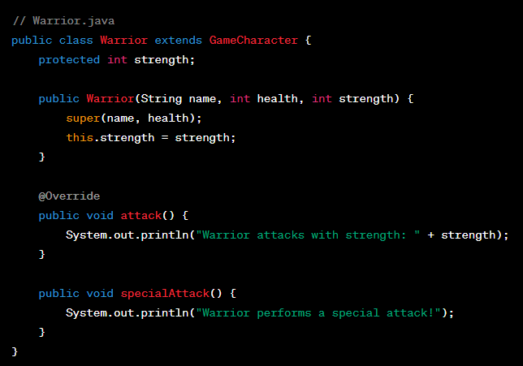

Slide 39
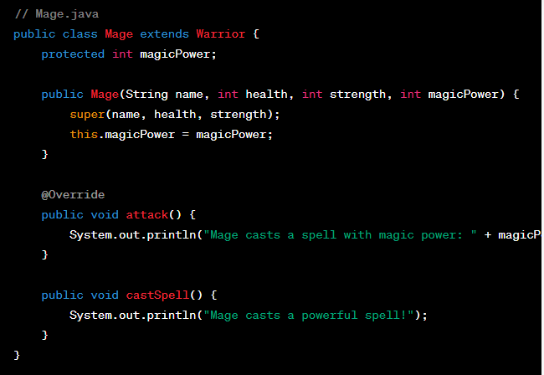

Slide 40


Slide 41
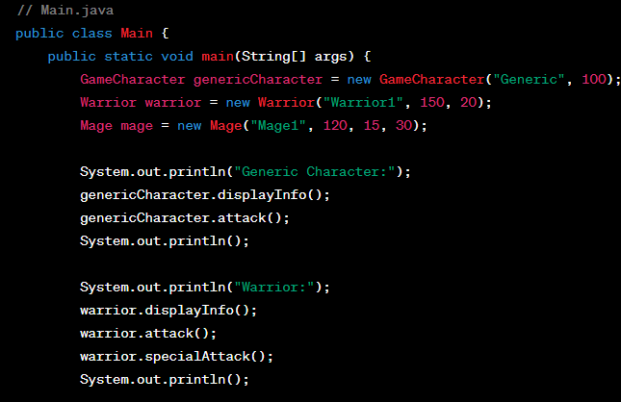

Slide 42


Slide 43
Concept of Method Overriding
Method overriding is a fundamental concept in object-oriented programming that allows a subclass to provide a specific implementation for a method that is already defined in its superclass.

Slide 44
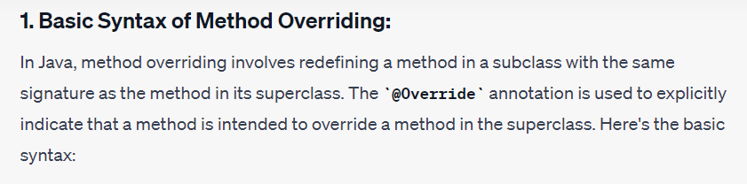

Slide 45
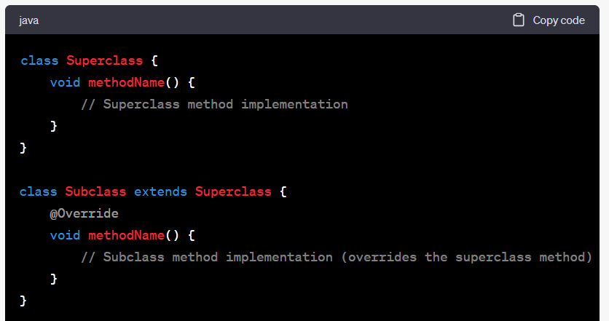

Slide 46
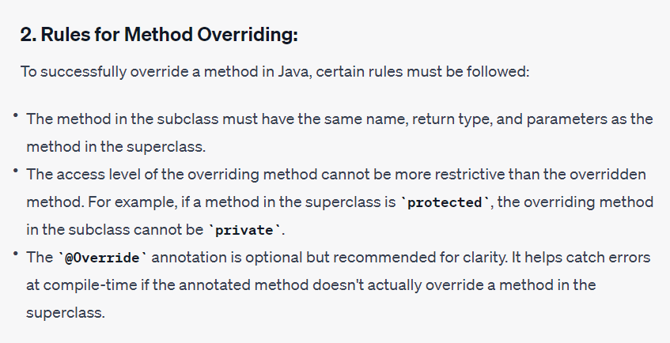

Slide 47
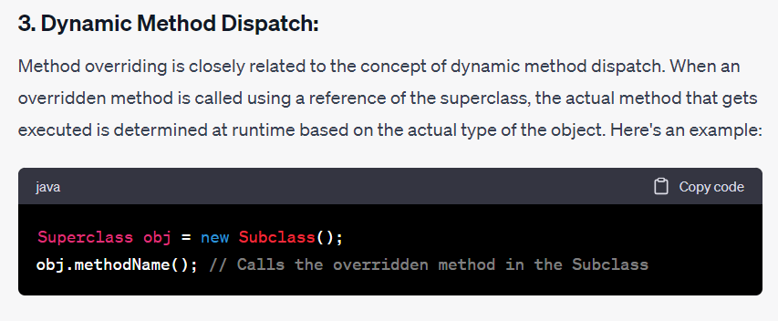

Slide 48
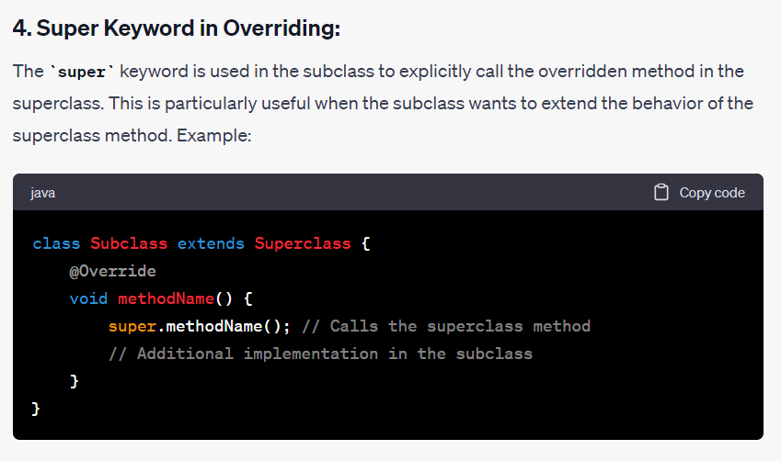

Slide 49
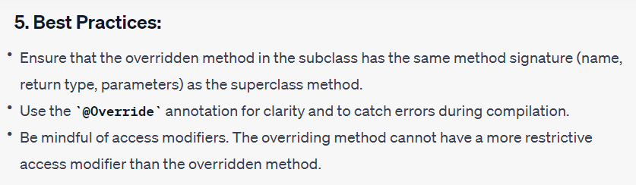

Slide 50
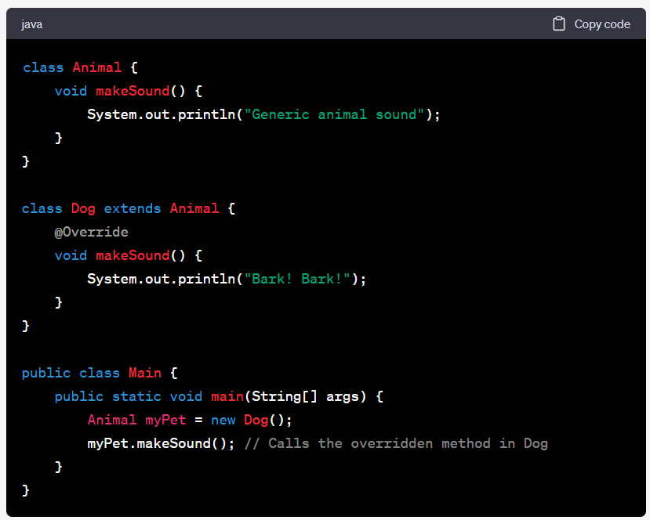

Slide 51
How to handle constructors in multilevel inheritance - super() and this()
In Java, constructors play a crucial role in the initialization of objects. When dealing with multilevel inheritance, understanding how to handle constructors becomes essential. In this tutorial, we'll explore how to effectively use super() and this() to manage constructors in a multilevel inheritance scenario.

Slide 52
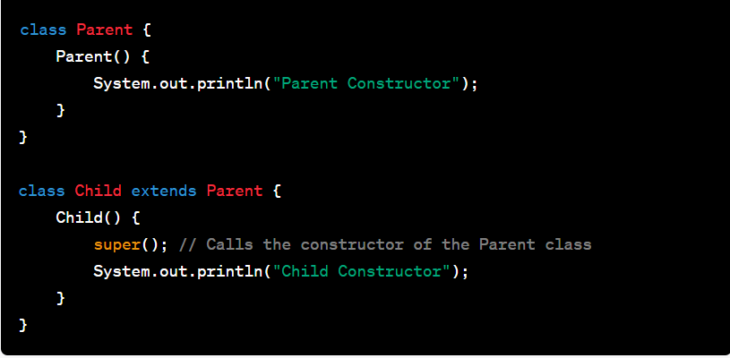
In Java, a constructor is a special method used for initializing objects. It has the same name as the class and is called automatically when an object is created. Constructors can be explicitly defined in a class to customize the initialization process.
Multilevel inheritance involves a chain of inheritance where a class extends another class, and then another class extends the second class, forming a hierarchy. In such scenarios, constructors need to be handled in a way that ensures proper initialization throughout the hierarchy.
Using super() in Constructors:
The super() keyword is used to invoke the constructor of the immediate parent class. It is particularly useful when a subclass wants to call the constructor of its superclass before executing its own constructor code. This is crucial in maintaining a proper initialization sequence.

Slide 53
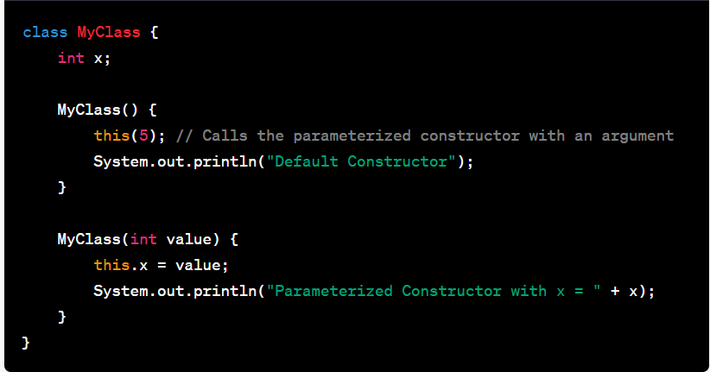
Using this() in Constructor:
The this() keyword is used to invoke another constructor within the same class. This is useful when a class has multiple constructors, and one constructor wants to call another to reuse initialization code.

Slide 54
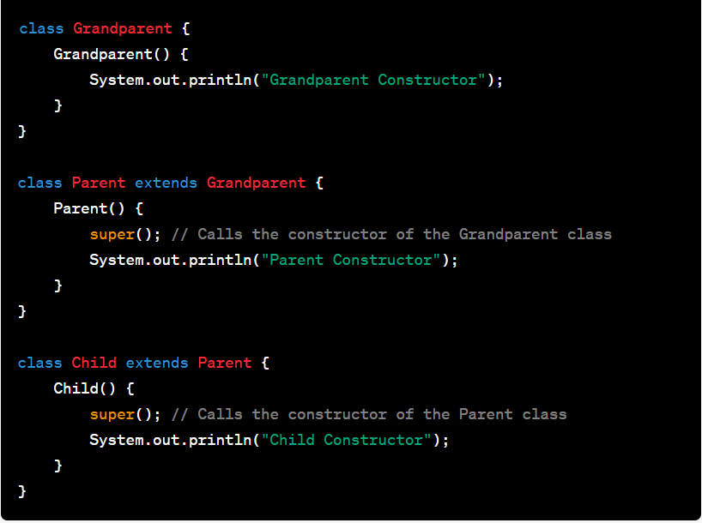
Combining super() and this() in multilevel inheritance:
In multilevel inheritance, a subclass may need to call both its immediate parent's constructor (super()) and its own constructors (this()). This ensures that the initialization process is propagated through the entire hierarchy.

Slide 55
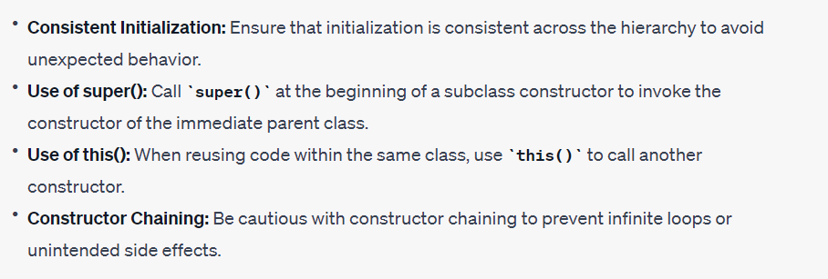
Best Practices and Considerations:

Slide 56
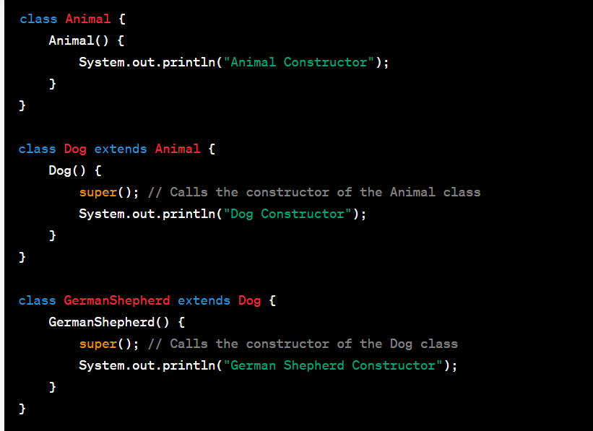

Slide 57
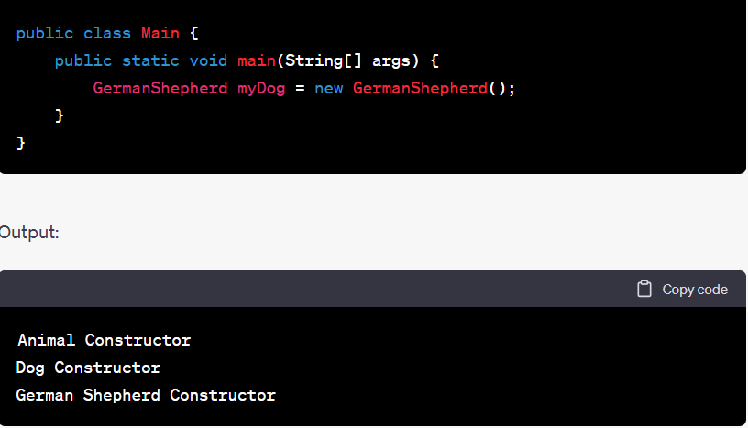

Slide 58
Conclusion
Handling constructors in multilevel inheritance is a crucial aspect of Java programming. By understanding the use of super() and this() keywords, developers can ensure proper initialization throughout class hierarchies. Consistent and thoughtful use of these techniques leads to maintainable and well-structured object-oriented code.

Slide 59
Significance of the final keyword
The final keyword in Java is a modifier that can be applied to classes, methods, and variables. It signifies various constraints and has different implications depending on where it is used.

Slide 60
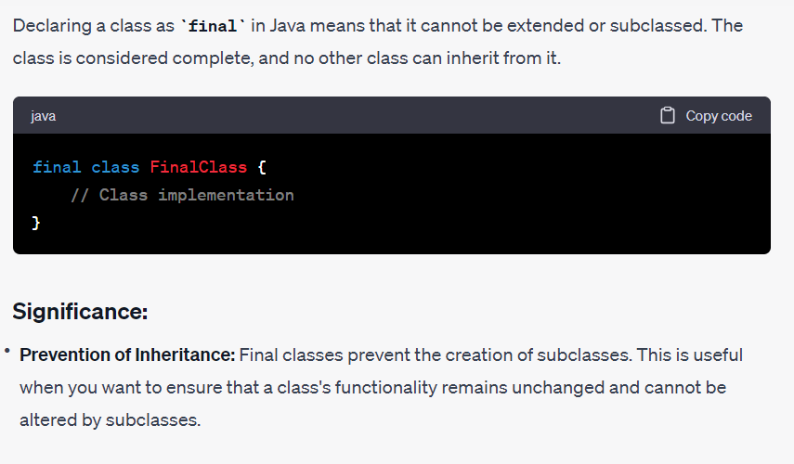
Final classes

Slide 61
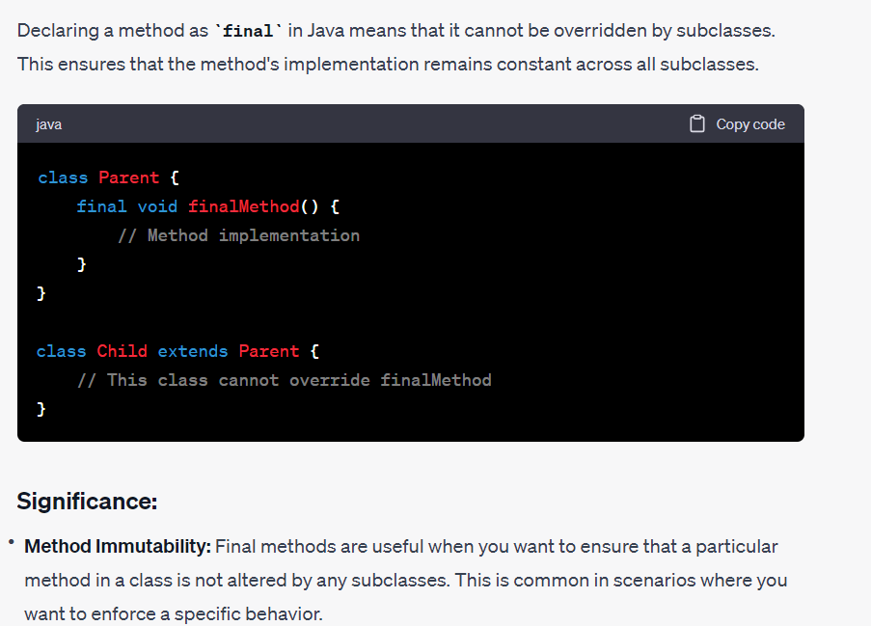
Final Methods

Slide 62
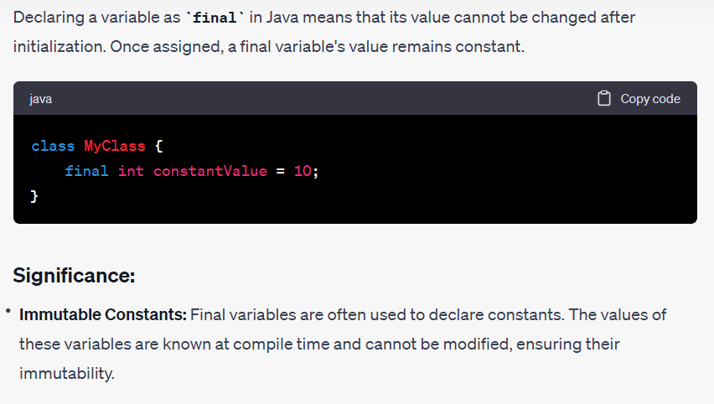
Final variables

Slide 63
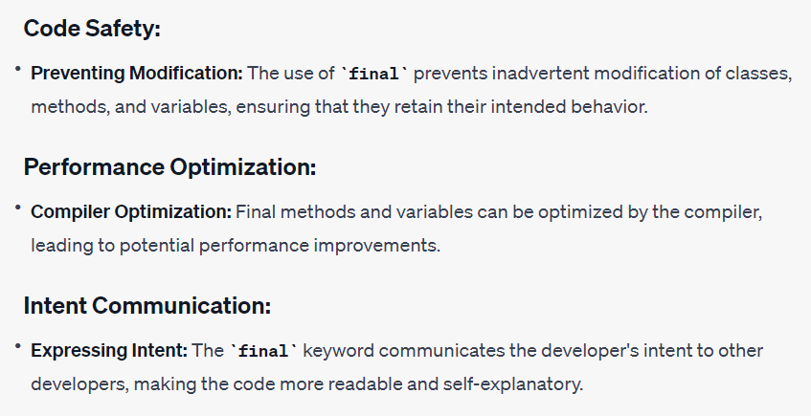
Benefits of final

Slide 64
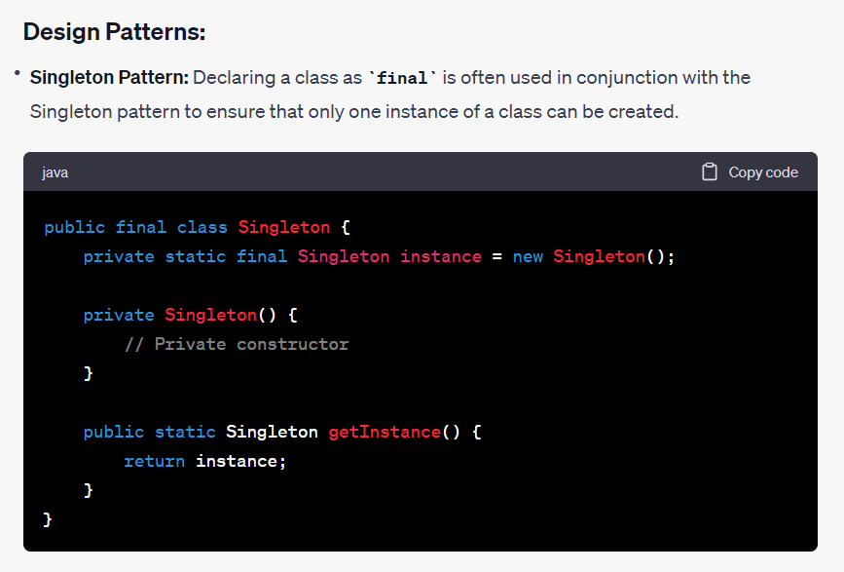
Common use cases

Slide 65
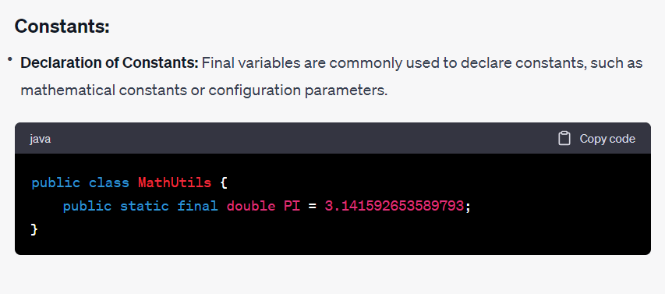

Slide 66
The final keyword in Java is a powerful tool for enforcing constraints and immutability in classes, methods, and variables. By using final, developers can communicate their intent, improve code safety, and optimize performance. Understanding the significance of final and its common use cases contributes to writing robust and maintainable Java code.

Slide 67
Abstract Classes and Interfaces

Slide 68
Concept of abstract class in Java
An abstract class in Java is a class that cannot be instantiated on its own and is typically used as a base class for other classes. It may contain abstract methods, concrete methods, or both. Abstract classes allow for the declaration of common methods and fields that subclasses must implement.

Slide 69
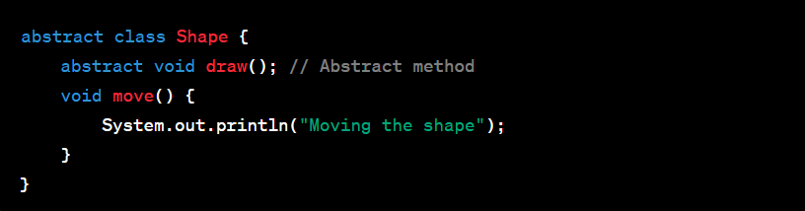

Slide 70
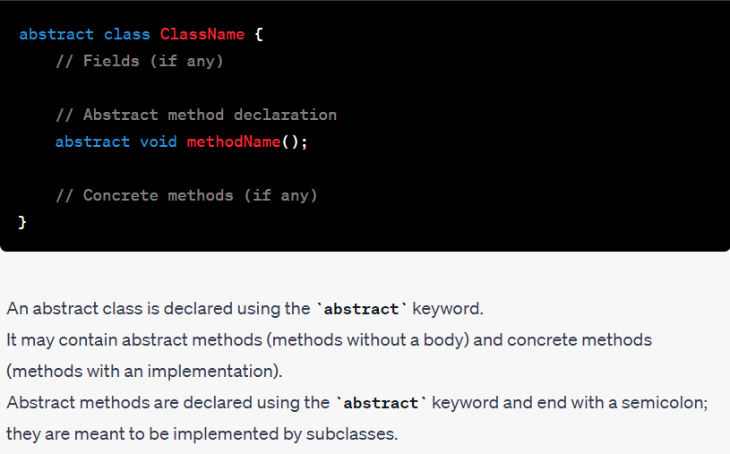
Syntax of abstract classes

Slide 71

Abstract methods

Slide 72

Creating subclasses

Slide 73

Abstract class versus interface

Slide 74

When to use abstract class?

Slide 75


Slide 76
Best Practices
Use abstract classes when you want to share code among several related classes.
Ensure that all abstract methods are implemented in subclasses.
Consider providing a default implementation for some methods to avoid duplication in subclasses.

Slide 77
Conclusion
Abstract classes in Java are a powerful tool for achieving abstraction and code reusability. By understanding their syntax, purpose, and best practices, developers can create well-structured class hierarchies that promote maintainability and extensibility in their Java applications.

Slide 78
What is an interface in Java?
In Java, interfaces provide a way to achieve abstraction, allowing you to define a contract that classes must adhere to. They play a crucial role in achieving multiple inheritance and creating a common structure for unrelated classes.

Slide 79

Introduction to interface

Slide 80

Syntax of interfaces

Slide 81
Interfaces can declare constant fields, abstract methods, default methods (from Java 8 onwards), and static methods (from Java 8 onwards).

Slide 82

Declaring methods in interfaces

Slide 83

Implementing Interfaces

Slide 84

Extending interfaces

Slide 85

Default methods

Slide 86

Static methods

Slide 87

Functional Interfaces

Slide 88

Marker Interfaces

Slide 89

When to use interfaces?

Slide 90


Slide 91
Best Practices
Prefer interfaces over abstract classes when defining contracts.
Use default methods for backward compatibility when adding new methods to interfaces.
Use marker interfaces judiciously, as they provide no method contract.

Slide 92
Conclusion
Interfaces in Java are a powerful tool for achieving abstraction, multiple inheritance, and code reusability. By understanding their syntax, features, and best practices, developers can create flexible and extensible code structures. Interfaces play a central role in designing modular and maintainable Java applications.

Slide 93
Concept of interface reference
In Java, you can use interface references to create more flexible and polymorphic code. An interface reference allows you to refer to objects of different classes that implement the same interface. This concept is known as polymorphism, and it's a key aspect of object-oriented programming.

Slide 94


Slide 95


Slide 96


Slide 97


Slide 100

Difference between object reference and interface reference

Slide 101
Concept of instanceof operator
The instanceof operator in Java is used to test whether an object is an instance of a particular class or interface. It returns a boolean value—true if the object is an instance of the specified type, and false otherwise. This operator is commonly employed in scenarios involving polymorphism and object type checking.

Slide 102

Syntax of instanceof operator

Slide 103

Use of instanceof operator

Slide 104


Slide 105


Slide 106


Slide 107


Slide 108

Best Practices and Considerations

Slide 109

Conclusion

Slide 110
Concept of Interface Inheritance
In Java, interface inheritance refers to the ability of one interface to inherit the methods and constants of another interface. This concept allows you to create a hierarchy of interfaces, promoting code reuse and providing a clear structure for organizing related functionality.

Slide 111


Slide 112


Slide 113


Slide 114


Slide 115

5. Implementation Classes

Slide 116


Slide 117
Concept of Dynamic Method Dispatch
Dynamic method dispatch is a powerful feature in Java that enables polymorphic behavior at runtime. It plays a crucial role in achieving run-time polymorphism, allowing a program to determine the actual implementation of a method associated with an object dynamically.

Slide 118


Slide 119


Slide 120


Slide 121


Slide 122

Abstract Class versus Interface

Slide 123


Slide 124


Slide 125
END OF UNIT 3…. PHEW!!!!!

